Slide 1
Field of View Measurement
Chart Size
Add Measurement
Width ( cm )
Height ( cm )
Device
S23U
Camera
W
16:9
142.2
80
Mode
photo
Resolution
12MP
4:3
106.6
80
Distance to the chart
103
cm
Aspect Ratio
Option
16:9ion
4:3
Add to list
Iphone 15 Pro Max_UW_video_FHD_30fps_16:9
S23_W_photo_12MP_4:3
VivoX100_T_photo_12MP_4:3
process

Slide 2
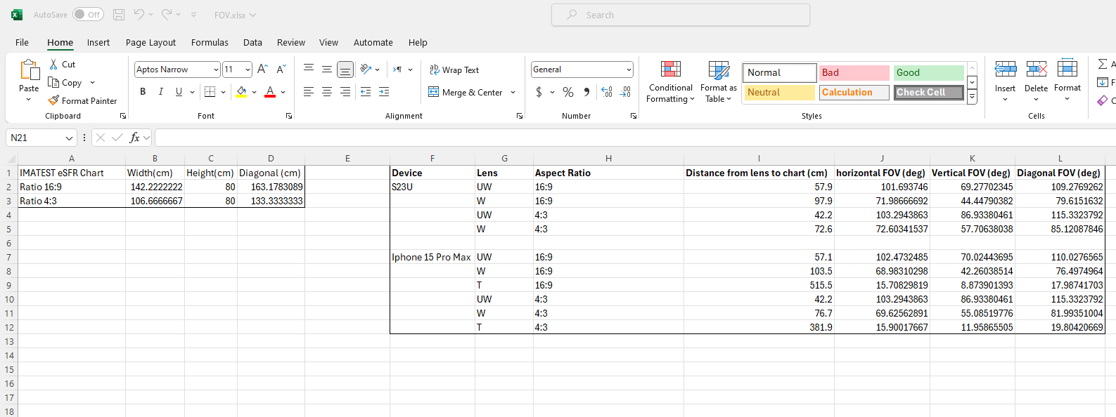
Expected Output – Excel file

